Slide 1
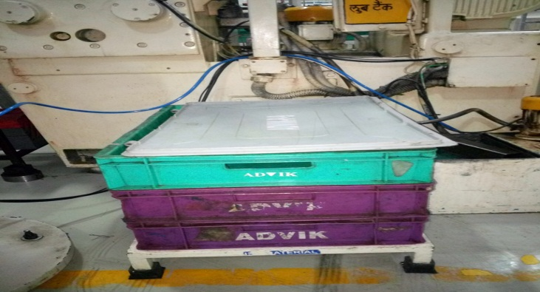
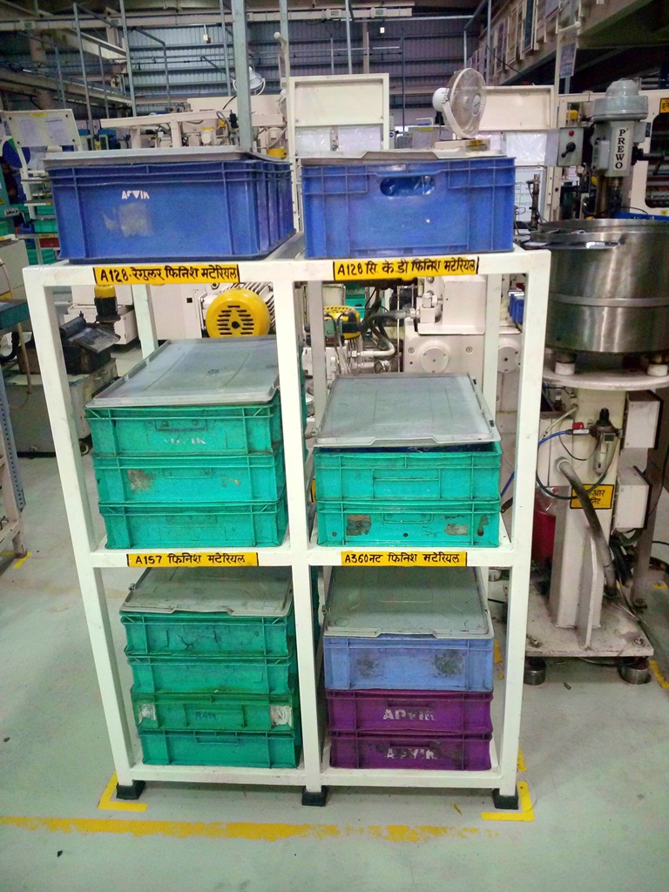
AHPL/QMS/FR/09/E
P15
KAIZEN NO :-
ACTIVITY
KK
QM
PM
JH
SHE
OT
DM
E&T
KAIZEN IDEA SHEET
TPM CIRCLE NAME:
LOSS NO. / STEP
DEPT :- MACHINE SHOP
RESULT AREA
P
Q
A,B,C
C
D
S
M
CELL:- Grinding
CELL NAME:- Grinding cell
MACHINE / STAGE : Nut & screw output location
OPERATION :- Storage output material
KAIZEN THEME : To reduce 1s ,2s time and std. location.
IDEA :-. Use of slotted angle rack for output material.
Problem / Present Status : Nut and screw storage separate stand which req. maximum space for storage.
COUNTERMEASURE:- Nut and screw store in slotted angle rack with identification.
BENCHMARK
Out put std. storage
TARGET
KAIZEN START
25.03.2017
TDC
2.05.2017
KAIZEN FINISH
2.05.2017
TEAM MEMBERS : 1.Sandip Jagtap.
2.Santosh Deshmukh.
BENEFITS :-
Out put material store in standard location with identification.
Machine surrounding area easy for cleaning.
Required surrounding space release.
Before
After
WHY - WHY ANALYSIS :-
Why1 :- Tapping machine output area found dirty and Critical for house keeping.
Why2:- Less height six stand use for out put material.
Why3 :- More space use for each part stand.
RESULT :-
N.A.
KAIZEN SUSTENANCE
WHAT TO DO:- Vibro machine output metal tray covered with plastic .
HOW TO DO:- Waste plastic material used for metal tray covering.
ROOT CAUSE :- floor and stand height less and multiple part use separate stand.
REGISTRATION NO. & DATE :
SCOPE & PLAN FOR HORIZONTAL DEPLOYMENT
REGISTERED BY :- Sandip Jagtap.
SR.
NO.
CELL
TARGET
RESPONSIBILITY
STATUS
MANAGER’S SIGN :- D. Y. Pawar
1
---
----
----
---
Rev. no: 01 Rev . Date:15.12.2016

